Slide 1
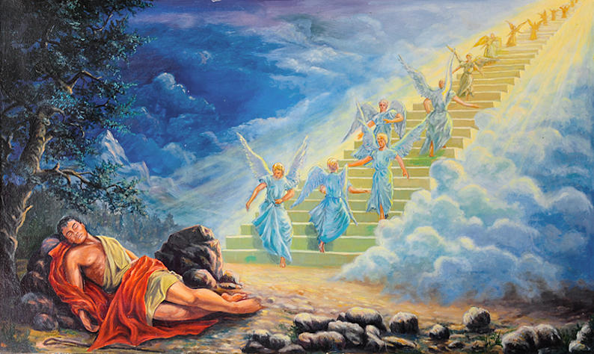
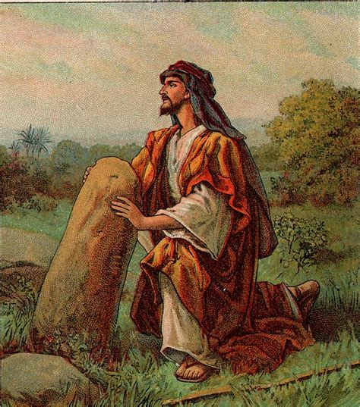
TORAH PARASHAH #7 “VAYETZE”
B’REISHEET 28:10-32
HOSHEA 12:12-14:10
YOCHANON 1:41-51

Slide 2
Blessing Before the Reading of the Torah
Ba-ruch a-tah Yah-u-eh, E-lo-hei-nu me-lech ha-o-lam
a-sher ba-char ba-nu-mi-kol ha-a-min
v’na-tan la-nu et-To-ra-to
Ba-ruch a-tah Yah-u-eh,
[All:]
Baruch Sh’mo no-tein ha-torah.
A-mein

Slide 3
Blessing Before the Reading of the Torah
[All:]
Blessed are You, Yahueh our Elohim, King of the Universe
Who has chosen us from among all peoples
And gave us His Torah
Blessed are You Yahueh
Bless His Name; Giver of the Torah!
Amen

Slide 4
Today’s Torah Reading B’reisheet 29:1-30
(1) And Yaacov moved on and came to the land of the people of the East. (2) And he looked and saw a well in the field, and saw three flocks of sheep lying by it, for out of that well they watered the flocks, and a large stone was on the well’s mouth. (3) And all the flocks would be gathered there, then they would roll the stone from the well’s mouth and water the sheep and put the stone back in its place on the well’s mouth. (4) So, Yaacov said to them, “My brothers, where are you from?” And they said, “We are from Haran.” (5) And he said to them, “Do you know Laban son of Nahor?” And they said, “We know him.” (6) So, he said to them, “Is he well?” And they said, “Well. And see, his daughter Rachel is coming with the sheep.” (7) And he said, “See, it is still high day, not the time for the livestock to be gathered together. Water the sheep and go and feed them.” (8) But they said, “We are not allowed until all the flocks are gathered together, and they have rolled the stone from the well’s mouth, then we shall water the sheep.” (9) While he was still speaking with them, Rachel came with her father’s sheep, for she was a shepherdess.

Slide 5
Today’s Torah Reading B’reisheet 29:1-30
(10) And it came to be, when Yaacov saw Rachel the daughter of Laban his mother’s brother, and the sheep of Laban his mother’s brother, that Yaaqov went near and rolled the stone from the well’s mouth and watered the flock of Laban his mother’s brother. (11) And Yaacov kissed Rachel and lifted up his voice and wept. (12) And when Yaacov told Rachel that he was her father’s relative and that he was Rivkah's son, she ran and told her father. (13) And it came to be, when Laban heard the report about Yaacov his sister’s son, that he ran to meet him, and embraced him and kissed him, and brought him to his house. Then he told Laban all these matters. (14) And Laban said to him, “You are indeed my bone and my flesh.” And he stayed with him for a new moon. (15) Then Laban said to Yaacov, “Because you are my relative, should you therefore serve me for naught? Let me know, what should your wages be?” (16) And Laban had two daughters, the name of the elder was Leah, and the name of the younger was Rachel. (17) And Leah’s eyes were weak, but Rachel was beautiful of form and beautiful of appearance. (18) And Yaacov loved Rachel, so he said, “Let me serve you seven years for Rachel your younger daughter.” (19) And Laban said, “It is better that I give her to you than that I should give her to another man. Stay with me.”

Slide 6
Today’s Torah Reading B’reisheet 29:1-30
(20) So, Yaacov served seven years for Rachel, and they seemed to him but a few days because of the love he had for her. (21) Then Yaacov said to Laban, “Give me my wife, for my days are completed, and let me go into her.” (22) And Laban gathered all the men of the place and made a feast. (23) And it came to be in the evening, that he took Leah his daughter and brought her to Yaacov. And he went into her. (24) And Laban gave his female servant Zilpah to his daughter Leah as a female servant. (25) And in the morning, it came to be, that see, it was Leah. So, he said to Laban, “What is this you have done to me? Was it not for Rachel that I served you? Why then have you deceived me?” (26) And Laban said, “It is not done this way in our place, to give the younger before the first-born. (27) Complete the week of this one, then we give you this one too, for the service which you shall serve with me still another seven years.” (28) And Yaacov did so and completed her week. Then he gave him his daughter Rachel too, as wife. (29) And Laban gave his female servant Bilhah to his daughter Rachel as a female servant. (30) And he also went into Rachel, and he also loved Rachel more than Leah. And he served with Laban still another seven years.

Slide 7
Blessing After the Reading of the Torah
[Leader:]
Ba-ruch a-tah Yah-u-eh, E-lo-hei-nu me-lech ha-o-lam
a-sher na-tan la-nu to-rat e-met
v’cha-yei o-lam na-ta be-to-chei-nu
Ba-ruch a-tah Yah-u-eh,
[All:]
Ba-ruch Sh’mo! no-tein ha-To-rah
A-mein.

Slide 8
Blessing After the Reading of the Torah
[All:]
Blessed are You, Yahueh our Elohim, King of the Universe
Who has given us the Torah of truth
and planted everlasting life within us!
Blessed are You Yahueh
Bless His Name
Giver of the Torah!
Amen

Slide 9
TORAH PARASHAH #7 “VAYETZE”
Torah Parashah and Outline Genesis 28:10-32:3
Chapter 28:10-22 “Yacov's Dream” Chapter 29:1-30 “Yacov Marries Leah and Rachel”
Chapter 29:31-30:24 “Yacov's Children” Chapter 30:25-43 “Yacov's Prosperity”
Chapter 31:1-55 “Yacov Flees from Laban” Chapter 32:1-3 “Yacov Fears Esau”
Haftarah Parashah and Outline Hosea 12:12-14:9
Chapter 12:12- 14 “YHWH's Indictment of Israel and Judah” cont.
Chapter 13:1-16 “YHWH's Relentless Judgment on Israel”
Chapter 14:1- 9 “A Plea to Return to YHWH”
Gospel Parashah John 1:41-51
Chapter 1:41-42 “Yeshua Calls the First Disciples” Chapter 1:43-51 “Yeshua Calls Philip and Nathanael”
During today’s Torah Parashah discussions consider:
Where is Yeshua? How is this relevant to us today?
What does this tell us about YHWH and his character?

Slide 10
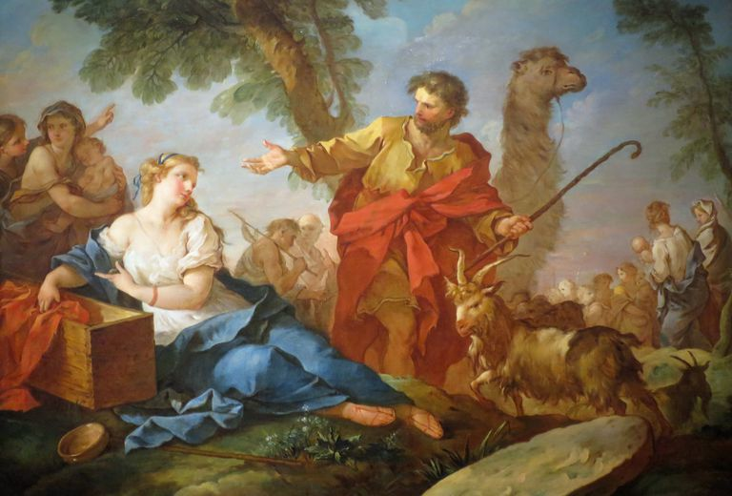
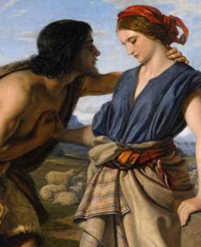
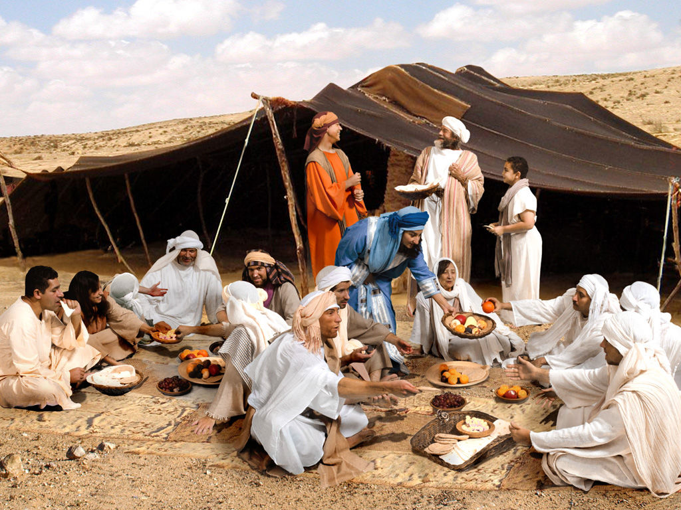
Torah Parashah Questions Genesis 28:10-32:3
In chapter 28 we read of Yaacov's dream.
What was the deal Yacov “struck” with YHWH and what part does this play in Yaacov's relationship with YHWH?
Reflect and discuss the components of the dream and whether they play a role in the country of Israel’s interaction with YHWH.
In chapters 29 and 30 we read of Yacov and the building of his family.
Fundamental Truth Review Question-Why is it important we learn about Yaacov's sons and their role in the past and future?
Reflect and discuss the components and processes whereby Yaacov's prosperity occurs.
In chapter 31 we read of Yacov fleeing Laban.
Review Question-explain how this story is a bit of tit for tat for Yacov.
This account has so many roles and components to it, it amazes me. Name the participants who influenced the events and the role they played.

Slide 11
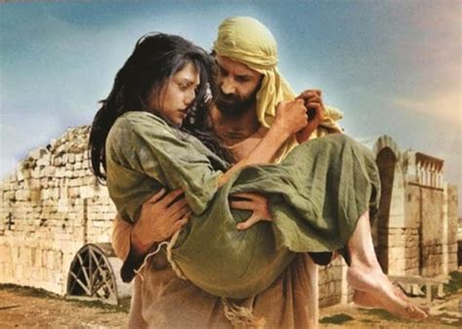
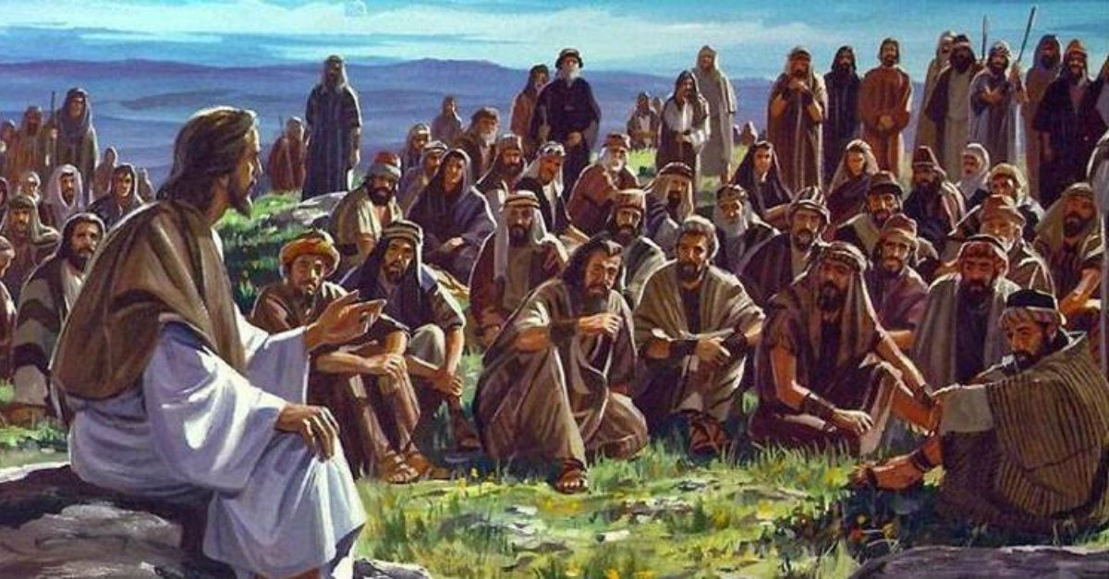
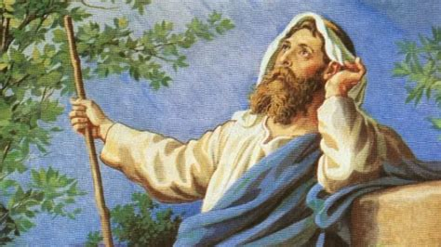
Haftarah Parashah Questions Hosea 12:12-14:9
If you begin reading in 12:2 you will better understand the meaning of YHWH’s indictment of Israel and Judah in this parashah.
It is interesting that Hosea says one of Yacov’s actions was a foreshadowing of a later event. Can you name another one? (Hint-the answer is in the Gospel Parashah.)
Identity Questions-Who are the prophet (12:13) and Ephraim (12:14)?
Prophecy Alert-Show how 13:14 is linked to Yeshua’s actions while on Earth. (BONUS-if you read two verses before this Haftarah Parashah, 12:10, which is part of this Biblical section, can you show how this is also linked to Yeshua’s actions while on Earth?) 😊
Identify the problem and the solution in this section and which of YHWH’s characteristics this reflects.
TORAH PARASHAH #7 “VAYETZE”

Slide 12
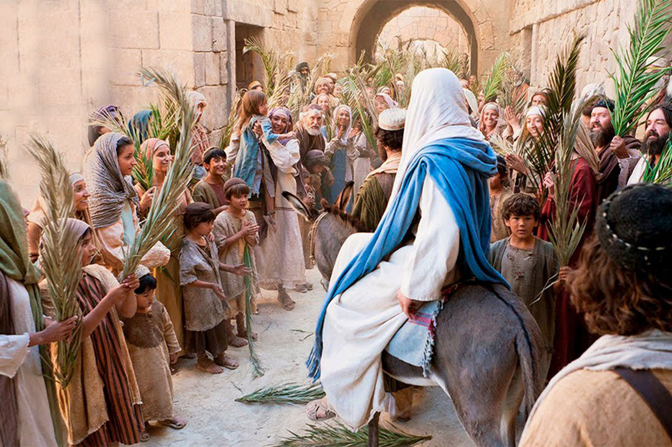
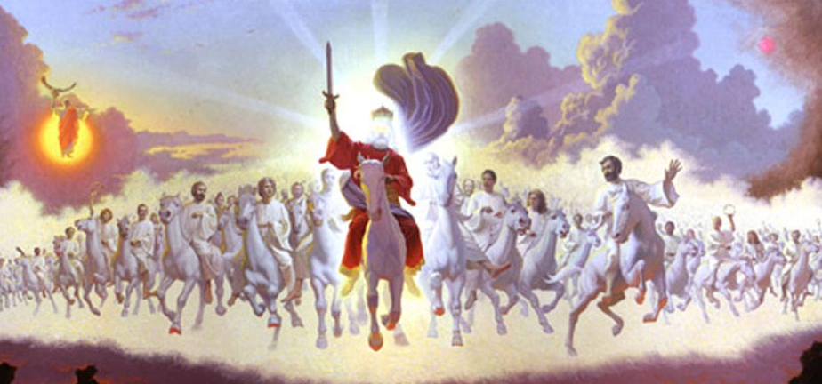
TORAH PARASHAH #7 “VAYETZE”
Gospel Parashah Questions
John 1:41-51
The Gospel of John is such an amazing account to read and here in this small section we read of several amazing events.
Name all the titles, and their roles, the disciples give Yeshua. How do these titles and roles affect Israel and the world?
Verse 45 states, “Philip found Nathaniel and said to him, “We have found Him whom Moshe wrote of in the Torah, and the prophets: Yeshua of Nazareth – the son of Yoseph.” Name some of these Torah references.
Why is this Gospel section tied to the Torah section?

