Slide 1
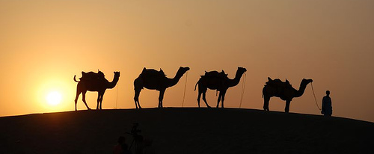
TORAH PARASHAH #3 “LECH LECHA”
B’reisheet 12:1 – 17:27 Isaiah 40:27 – 41:16 JOHN 8:51 - 58

Slide 2
Blessing Before the Reading of the Torah
[Leader:]
Ba-r’chu et Yah-u-eh ha-m’vo-rach!
Bless Yahueh, the Blessed One
[All:]
Ba-ruch Yah-u-eh, ha-m’vo-rach l’o-lam va-ed!
Blessed is Yahueh, the Blessed One, for all eternity
[Leader:]
Ba-ruch Yah-u-eh ha-m’vo-rach l’o-lam va-ed!

Slide 3
Ba-ruch a-tah Yah-u-eh, E-lo-hei-nu me-lech ha-o-lam
Blessed are You, Yahueh our Elohim, King of the Universe
a-sher ba-char ba-nu-mi-kol ha-a-min
Who has chosen us from among all peoples
v’na-tan la-nu et-To-ra-to
And gave us His Torah
Ba-ruch a-tah Yah-u-eh,
Blessed are You Yahueh
[All:] (Baruch Sh’mo)
Bless His Name
no-tein ha-torah.
Giver of the Torah!
[All:] (A-mein)

Slide 4
TODAY’S TORAH READING B’reisheet 12:1 - 20
(1) Now YHWH said unto Abram: 'Get thee out of thy country, and from thy kindred, and from thy father's house, unto the land that I will show thee. (2) And I will make of thee a great nation, and I will bless thee, and make thy name great; and be thou a blessing. (3) And I will bless them that bless thee, and him that curseth thee will I curse; and in thee shall all the families of the earth be blessed.’ (4) So Abram went, as YHWH had spoken unto him; and Lot went with him; and Abram was seventy and five years old when he departed out of Haran. (5) And Abram took Sarai his wife, and Lot his brother's son, and all their substance that they had gathered, and the souls that they had gotten in Haran; and they went forth to go into the land of Canaan; and into the land of Canaan, they came. (6) And Abram passed through the land unto the place of Shechem, unto the terebinth of Moreh. And the Canaanite was then in the land. (7) And YHWH appeared unto Abram and said: 'Unto thy seed will I give this land'; and he builded there an altar unto YHWH, who appeared unto him. (8) And he removed from thence unto the mountain on the east of Beth-el, and pitched his tent, having Beth-el on the west, and Ai on the east; and he builded there an altar unto YHWH, and called upon the name of YHWH. (9) And Abram journeyed, going on still toward the South.

Slide 5
TODAY’S TORAH READING B’reisheet 12:1 - 20
(10) And there was a famine in the land; and Abram went down into Egypt to sojourn there; for the famine was sore in the land. (11) And it came to pass, when he was come near to enter into Egypt, that he said unto Sarai his wife: 'Behold now, I know that thou art a fair woman to look upon. (12) And it will come to pass, when the Egyptians shall see thee, that they will say: This is his wife; and they will kill me, but thee they will keep alive. (13) Say, I pray thee, thou art my sister; that it may be well with me for thy sake, and that my soul may live because of thee.’ (14) And it came to pass, that, when Abram was come into Egypt, the Egyptians beheld the woman that she was very fair. (15) And the princes of Pharaoh saw her and praised her to Pharaoh; and the woman was taken into Pharaoh's house. (16) And he dealt well with Abram for her sake; and he had sheep, and oxen, and he-asses, and men-servants, and maid-servants, and she-asses, and camels. (17) And YHWH plagued Pharaoh and his house with great plagues because of Sarai Abram's wife. (18) And Pharaoh called Abram, and said: 'What is this that thou hast done unto me? why didst thou not tell me that she was thy wife? (19) Why saidst thou: She is my sister? so that I took her to be my wife; now therefore behold thy wife, take her, and go thy way.’ (20) And Pharaoh gave men charge concerning him; and they brought him on the way, and his wife, and all that he had.

Slide 6
Blessing after the reading of the Torah
[Leader:]
Ba-ruch a-tah Yah-u-eh, E-lo-hei-nu me-lech ha-o-lam
Blessed are You, Yahueh our Elohim, King of the Universe
a-sher na-tan la-nu to-rat e-met
Who has given us the Torah of truth
v’cha-yei o-lam na-ta be-to-chei-nu
and planted everlasting life within us!
Ba-ruch a-tah Yah-u-eh,
Blessed are You Yahueh
[All:] (Ba-ruch Sh’mo!)
Bless His Name
no-tein ha-To-rah
Giver of the Torah!
[All:] (A-mein)

Slide 7
TORAH PARASHAH #3 “LECH LECHA””
Torah Portion and Outline B’reisheet 12:1 – 17:27
Chapter 12:1 – 9 “The Call of Abram” Chapter 12:10 – 20 “Abram and Sarai in Egypt”
Chapter 13:1 – 18 “Abram and Lot Separate” Chapter 14:1 – 16 “Abram Rescues Lot”
Chapter 14:17 – 24 “Abram Blessed by Melchizedek” Chapter 15:1 – 21 “YHWH's Covenant with Abram”
Chapter 16:1 – 16 “Sarai and Hagar” Chapter 17:1 – 14 “Abraham and the Covenant of
Circumcision”
Chapter 17:15 – 27 “Isaac's Birth Promised”
Haftarah Portion and Outline Isaiah 40:27 – 41:16
Chapter 40:27 – 31 “The Greatness of YHWH” cont. Chapter 41:1 – 16 “Fear Not, for I Am with You”
Gospel Portion and Outline John 8:51 – 58
Chapter 8:51 – 58 “Before Abraham Was, I Am” cont.
During today’s Torah Parashah discussions consider:
Where is Yeshua? How is this relevant to us today?

Slide 8
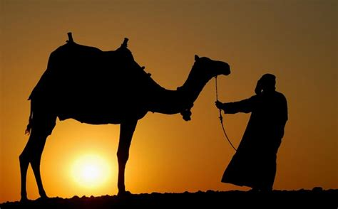
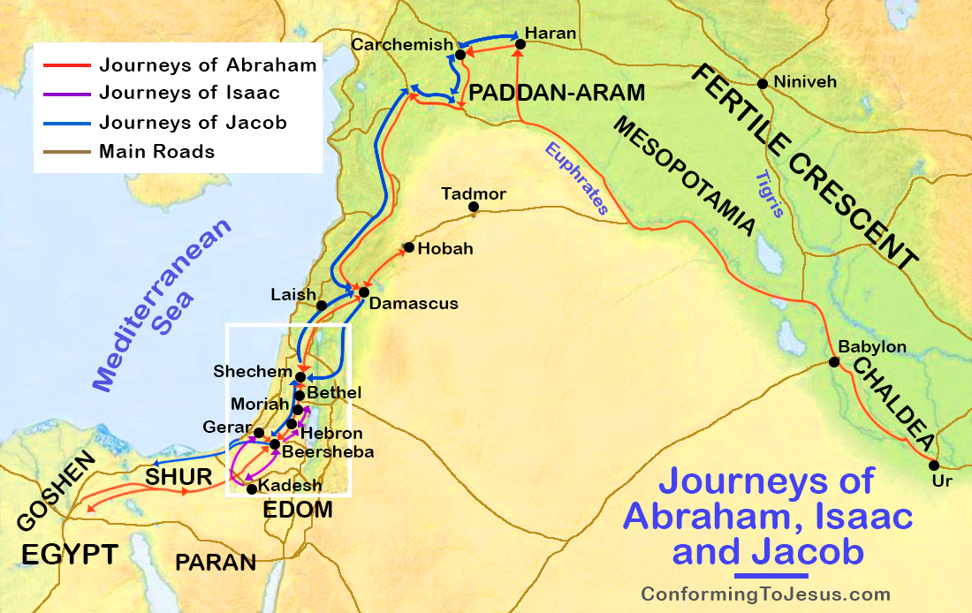
Torah Parashah Questions for Discussion B’reisheet 12:1 – 17:27
Why did Abram and Lot separate? What lesson is there to learn from this account and apply to your life today?
When we read of Abram rescuing Lot, what do we learn about Abram’s character? What do we learn about family structure and responsibility?
Genesis 15:7 states, “And he said unto him, I am YHWH that brought thee out of Ur of the Chaldees, to give thee this land to inherit it.” Where is Ur, and what was the culture of the Chaldees? How does this apply to us today?
Genesis 15:12 states, “And when the sun was going down, a deep sleep fell upon Abram; and, lo, an horror of great darkness fell upon him.” What is this horror of great darkness?

Slide 9
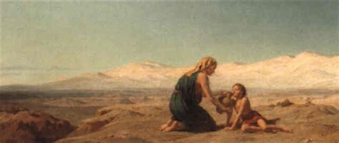
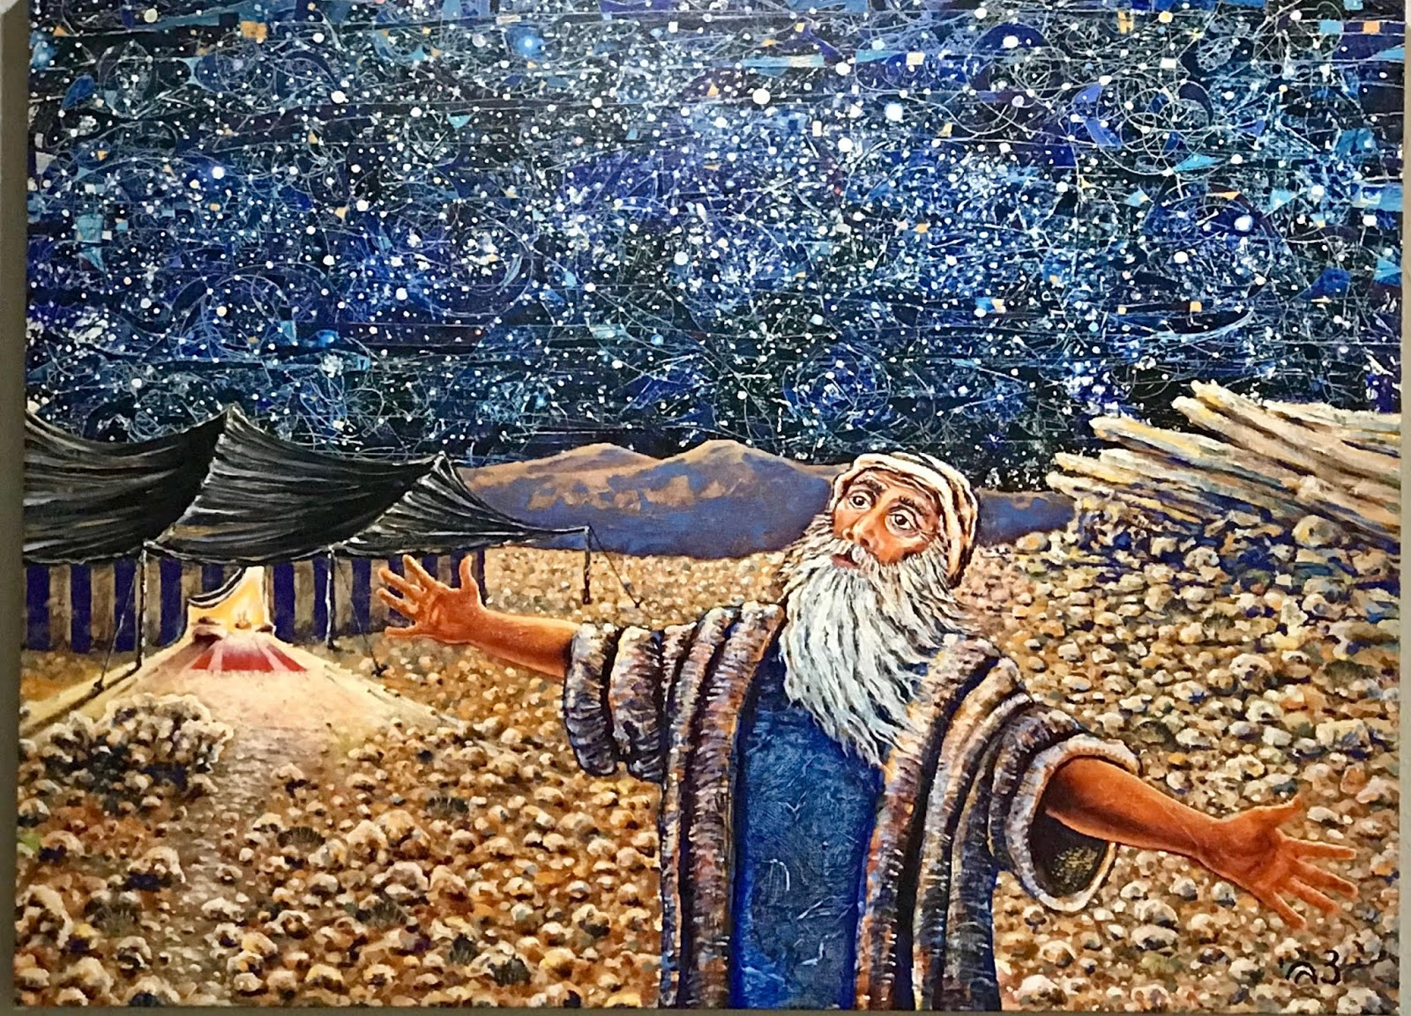
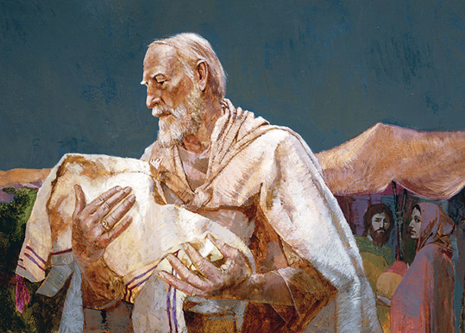
Torah Parashah Questions for Discussion B’reisheet 12:1 – 17:27
5. In Chapters 15 and 17, Abram enters into two covenants with YHWH. What are they, and what do these have to do with us?
6. Gen 15:16: the Israelites will return from Egypt "for the iniquity of the Amorites is not yet complete." Where else does YHWH allow a sinful person or society to continue, and for what purpose?
7. What lessons do you learn from the account of Sarai and Hagar? How is this situation affecting the Middle East today?
8. In reading the section of YHWH’s covenant with Abraham and the covenant of circumcision, I am reminded of the old question, “Which came first, the chicken or the egg?” Because my question for you is, “Which came first, salvation or circumcision?” Why is this important to us today and to the early believers in Yeshua?

Slide 10
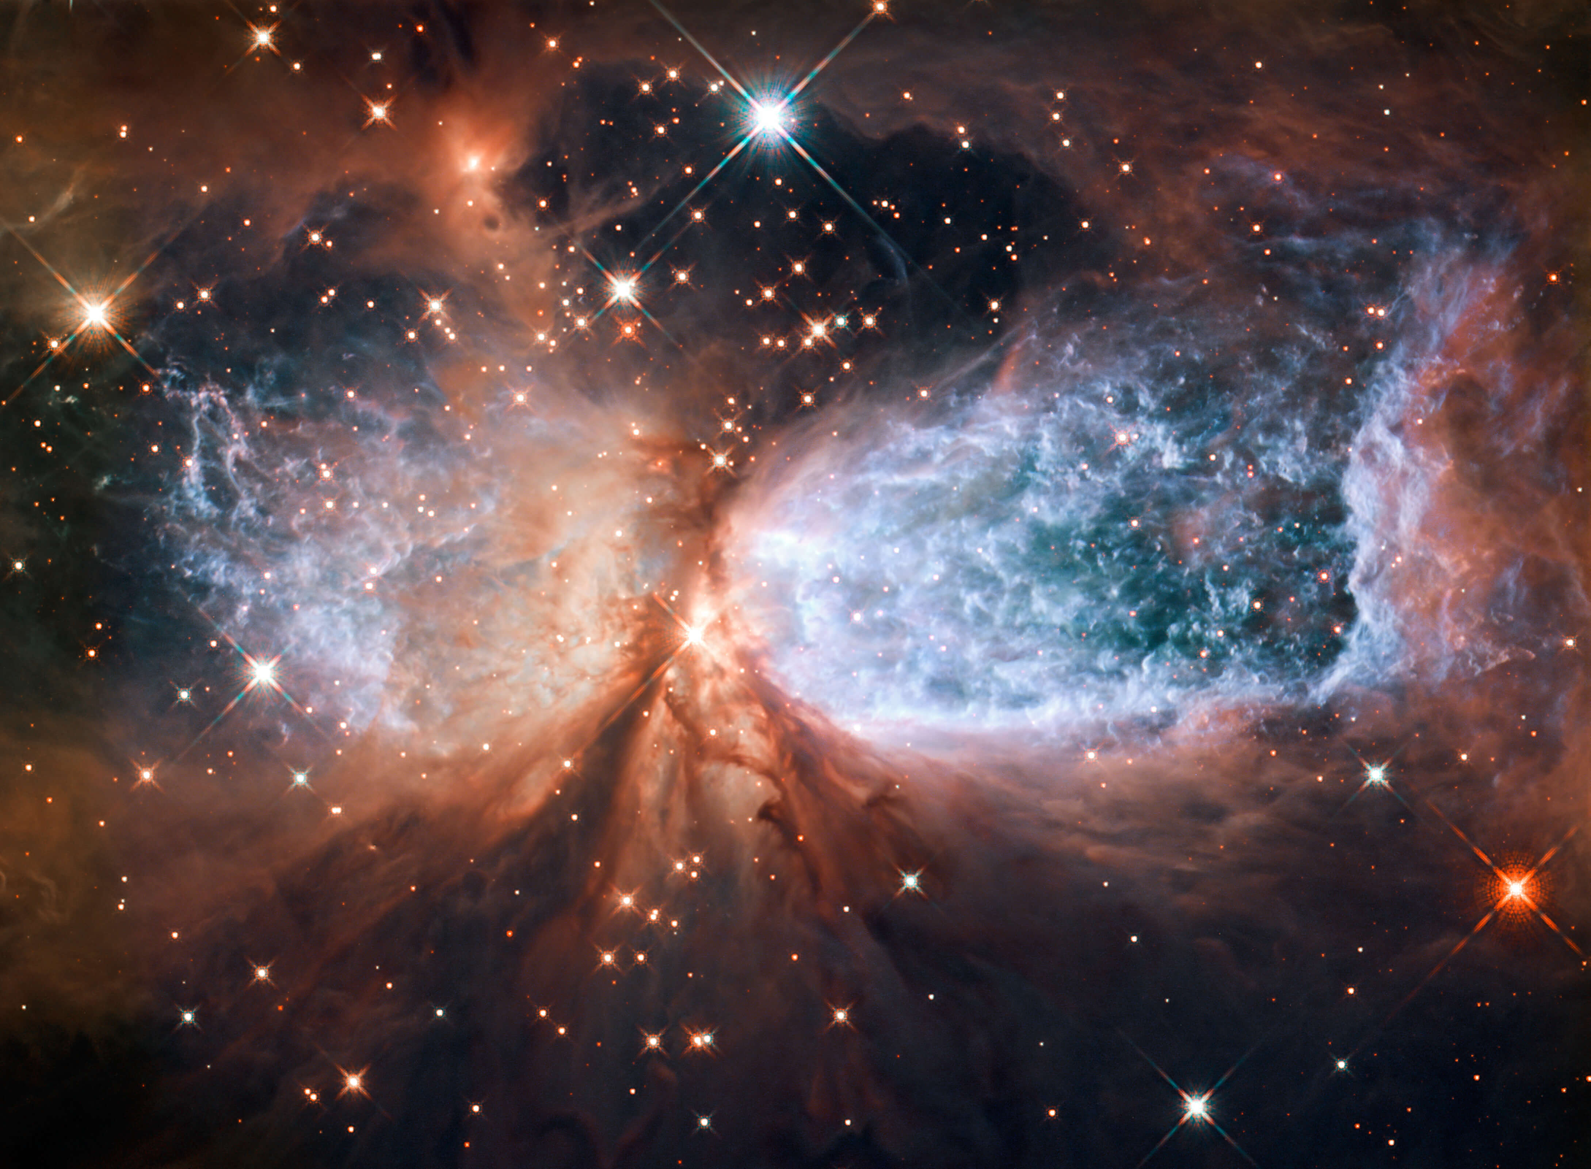
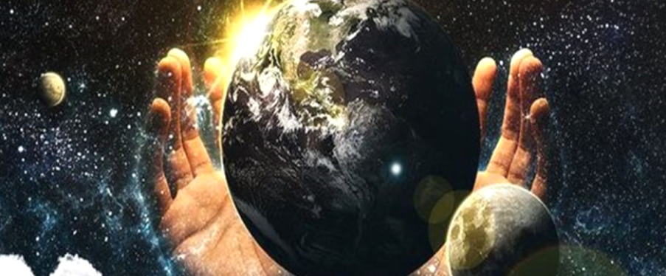
Haftarah Parashah Questions for Discussion Isaiah 40:27 – 41:16
Chapter 40 is entitled, “The Greatness of YHWH.” Why should we remember His greatness?
Identify in chapter 41 what the reader is encouraged to do instead of fearing.
Isaiah 41:14 states, “Fear not, thou worm Jacob, and ye men of Israel; I will help thee, saith YHWH, and thy redeemer, the Holy One of Israel.” YHWH repeatedly calls Himself redeemer. Why is that? How can that apply to us today?
Scholar Alert- Isaiah 41:16 states, “Thou shalt fan them, and the wind shall carry them away, and the whirlwind shall scatter them: and thou shalt rejoice in YHWH, and shalt glory in the Holy One of Israel.” Research and discuss the Hebrew words “rejoice” and “glory” in this verse.

Slide 11
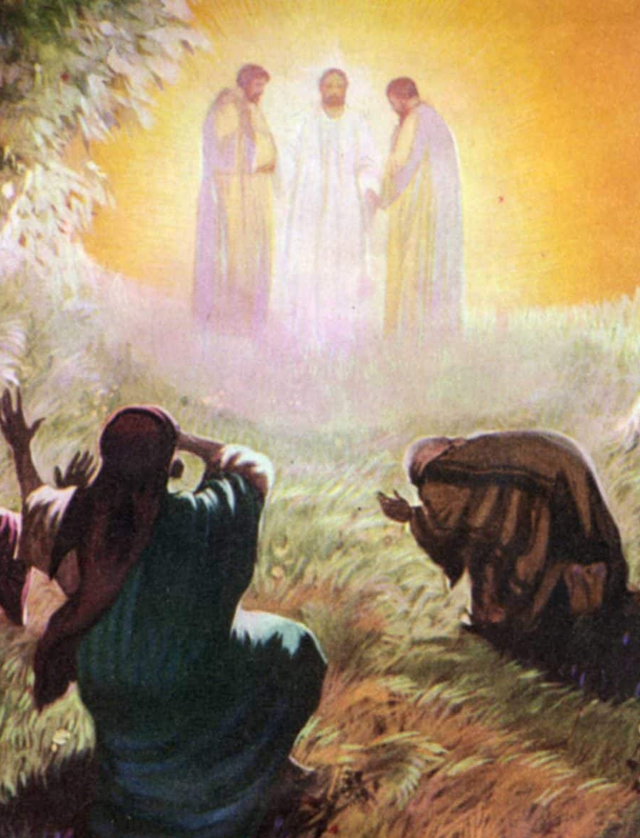
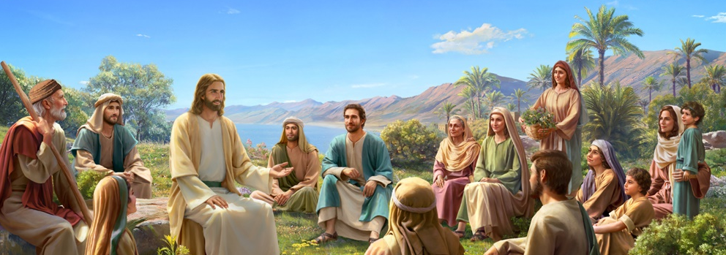
Gospel Parashah Questions for Discussion John 8:51 – 58
John 8:51 states, “Truly, truly, I say to you, if anyone guards My Word, he shall never see death at all.” What does Yeshua mean?
When Yeshua is talking to the Jews, why does He call them liars in verse 55?
Verse 58 states, “Yeshua said unto them, Verily, verily, I say unto you, Before Abraham was, I am.” What is Yeshua talking about?

