Slide 1
TORAH PARASHAH “NOACH”
B’reisheet 6:9 – 11:32 Isaiah 54:1 – 55:5 Luke 17:20 - 27

Slide 2
Blessing Before the Reading of the Torah
[Leader:]
Ba-r’chu et Yah-u-eh ha-m’vo-rach!
Bless Yahueh, the Blessed One
[All:]
Ba-ruch Yah-u-eh, ha-m’vo-rach l’o-lam va-ed!
Blessed is Yahueh, the Blessed One, for all eternity
[Leader:]
Ba-ruch Yah-u-eh ha-m’vo-rach l’o-lam va-ed!

Slide 3
Ba-ruch a-tah Yah-u-eh, E-lo-hei-nu me-lech ha-o-lam
Blessed are You, Yahueh our Elohim, King of the Universe
a-sher ba-char ba-nu-mi-kol ha-a-min
Who has chosen us from among all peoples
v’na-tan la-nu et-To-ra-to
And gave us His Torah
Ba-ruch a-tah Yah-u-eh,
Blessed are You Yahueh
[All:] (Baruch Sh’mo)
Bless His Name
no-tein ha-torah.
Giver of the Torah!
[All:] (A-mein)

Slide 4
TODAY’S TORAH READING B’reisheet 8:15 – 9:17
(15) And Elohim spoke to Noach, saying, (16) “Go out of the ark, you and your wife and your sons and your sons’ wives with you. (17) Bring out with you every life form of all flesh that is with you: of birds, of cattle and all creeping creatures – the creeping creatures on the earth. And let them teem on the earth, and bear and increase on the earth.” (18) So, Noach went out, and his sons and his wife and his sons’ wives with him, (19) every beast, every creeping creature, and every bird, whatever creeps on the earth, according to their kinds, went out of the ark. (20) And Noach built a slaughter-place to יהוה, and took of every clean beast and of every clean bird, and offered ascending offerings on the slaughter-place. (21) And יהוה smelled a soothing fragrance, and יהוה said in His heart, “Never again shall I curse the ground because of man, although the inclination of man’s heart is evil from his youth, and never again strike all living creatures, as I have done, (22) as long as the earth remains, seedtime and harvest, and cold and heat, and summer and winter, and day and night shall not cease.”

Slide 5
TODAY’S TORAH READING B’reisheet 8:15 – 9:17
(9:1) And Elohim blessed Noach and his sons, and said to them, “Be fruitful and increase, and fill the earth. (2) And the fear of you and the dread of you is on every beast of the earth, on every bird of the heavens, on all that creeps on the ground, and on all the fish of the sea – into your hand they have been given. (3) Every creeping creature that lives is food for you. I have given you all, as I gave the green plants. (4) But do not eat flesh with its life, its blood. (5) But only your blood for your lives I require, from the hand of every beast I require it, and from the hand of man. From the hand of every man’s brother, I require the life of man.(6) Whoever sheds man’s blood, by man his blood is shed, for in the image of Elohim has He made man. (7) As for you, be fruitful and increase, bring forth teemingly in the earth and increase in it.” (8) And Elohim spoke to Noach and to his sons with him, saying, (9 ) “And I, see, I establish My covenant with you and with your seed after you,

Slide 6
TODAY’S TORAH READING B’reisheet 8:15 – 9:17
(10) and with every living being that is with you: of the birds, of the cattle, and of every beast of the earth with you, of all that go out of the ark, every beast of the earth. (11) And I shall establish My covenant with you, and never again is all flesh cut off by the waters of the flood, and never again is there a flood to destroy the earth. (12) And Elohim said, “This is the sign of the covenant which I make between Me and you, and every living being that is with you, for all generations to come: (13) I shall set My rainbow in the cloud, and it shall be for the sign of the covenant between Me and the earth. (14) And it shall be, when I bring a cloud over the earth, that the rainbow shall be seen in the cloud, (15) and I shall remember My covenant which is between Me and you and every living being of all flesh, and never again let the waters become a flood to destroy all flesh. (16) And the rainbow shall be in the cloud, and I shall see it, to remember the everlasting covenant between Elohim and every living being of all flesh that is on the earth.” (17) And Elohim said to Noach, “This is the sign of the covenant which I have established between Me and all flesh that is on the earth.”

Slide 7
Blessing after the reading of the Torah
[Leader:]
Ba-ruch a-tah Yah-u-eh, E-lo-hei-nu me-lech ha-o-lam
Blessed are You, Yahueh our Elohim, King of the Universe
a-sher na-tan la-nu to-rat e-met
Who has given us the Torah of truth
v’cha-yei o-lam na-ta be-to-chei-nu
and planted everlasting life within us!
Ba-ruch a-tah Yah-u-eh,
Blessed are You Yahueh
[All:] (Ba-ruch Sh’mo!)
Bless His Name
no-tein ha-To-rah
Giver of the Torah!
[All:] (A-mein)

Slide 8
TORAH PARASHAH #2 “NOACH”
Torah Portion and Outline Genesis 6:9 – 11:32
Chapter 6:9 – 7:24 “Noah and the Flood” Chapter 8:1 – 19 “The Flood Subsides”
Chapter 8:20 – 9:17 “YHWH's Covenant with Noah” Chapter 9:18 – 29 “Noah's Descendants”
Chapter 10:1 – 32 “Nations Descended from Noah” Chapter 11:1 – 9 “The Tower of Babel”
Chapter 11:10 – 26 “Shem’s Descendants” Chapter 11:27 – 32 “Terah's Descendants”
Haftarah Portion and Outline Isaiah 54:1 – 55:5
Chapter 54:1 – 17 “The Eternal Covenant of Peace” Chapter 55:1 – 5 “The Compassion of the Lord”
Gospel Portion and Outline Luke 17:20 – 27
Chapter 17:20 – 27 “The Coming of the Kingdom”
During today’s Torah Parashah discussions consider:
Where is Yeshua? How is this relevant to us today?

Slide 9
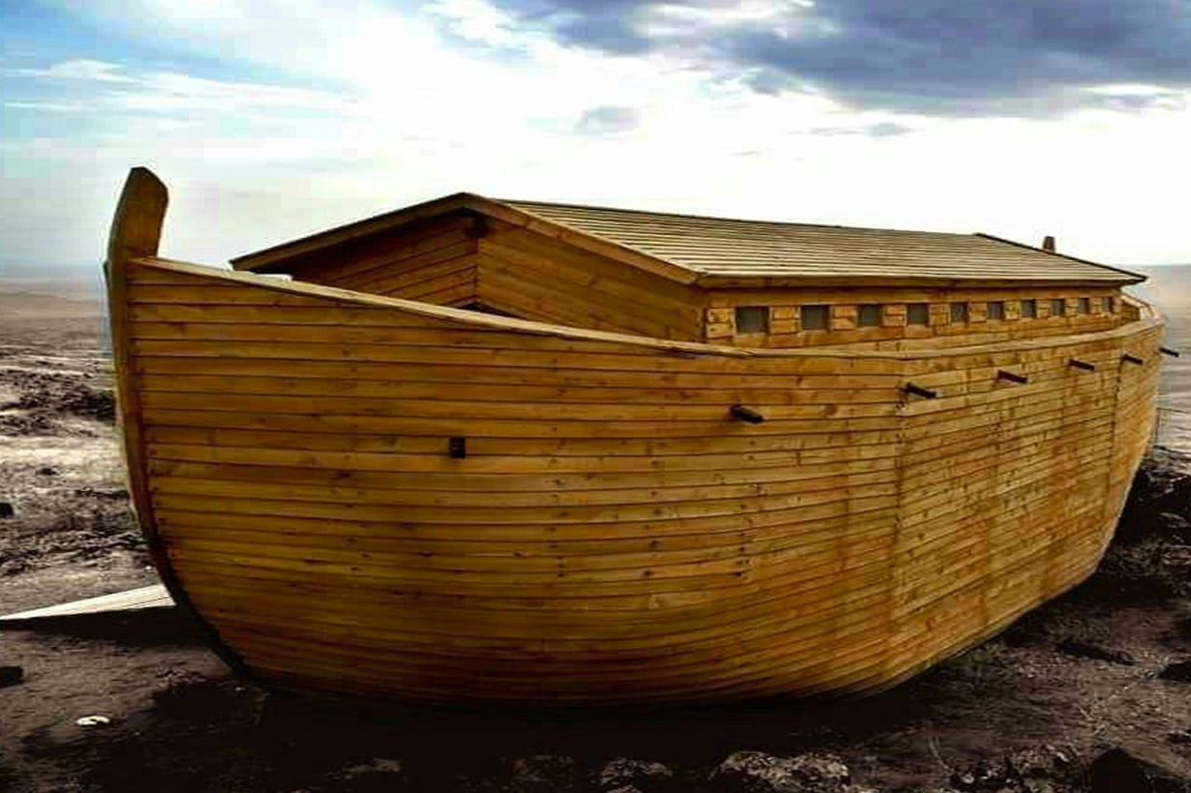
TORAH PARASHAH #2 “NOACH”
Torah Parashah Questions for Discussion Genesis 6:9 – 11:32
Treasure Hunt Alert! Noah’s flood is referenced many times in Scripture. The purpose of some of these questions is for you to find the references and see how those authors used Noah’s flood in their writings. Have fun!
For decades there has been a relentless attack by YHWH’s enemy to destroy the validity of Noah’s Flood and its aftermath, making it a subject seemingly trivial to many believers today. Can you explain why the enemy is doing this?
Do you believe the flood historically happened or is it just a nice moral story, like when Yeshua told a parable? Be ready to defend your answer! 😊
I was taught the animals went into the ark two by two, male and female. Then why do some Bibles say fourteen of them in 7:3?
Skeptics say … “Well, we know the flood couldn’t have happened because all the animal types we see today couldn’t have fit into such a little boat.” What is your rebuttal to this argument?

Slide 10
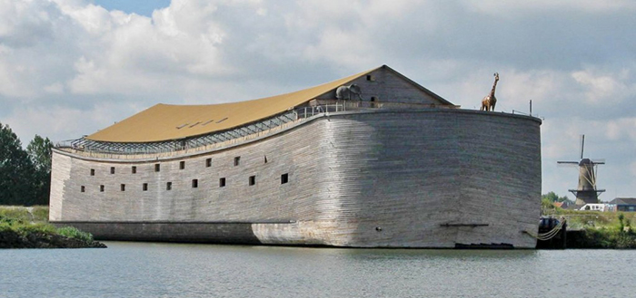
TORAH PARASHAH #2 “NOACH”
Torah Parashah Questions for Discussion Genesis 6:9 – 11:32
5. Regarding the controversy concerning whether the flood event occurred or not, explain this controversy’s relevance to YHWH’s coming judgement of the world by fire. (Hint-Read 1 Peter 2 and 3.)
6. In chapter eight we read the flood subsides. If the flood happened, where did all the water go?
7. What is YHWH’s covenant with Noah, and how does that affect us?
8. The Tower of Babel story certainly explains why so many languages on earth exist today. Why did YHWH confound their language and are there efforts today to reverse this?

Slide 11
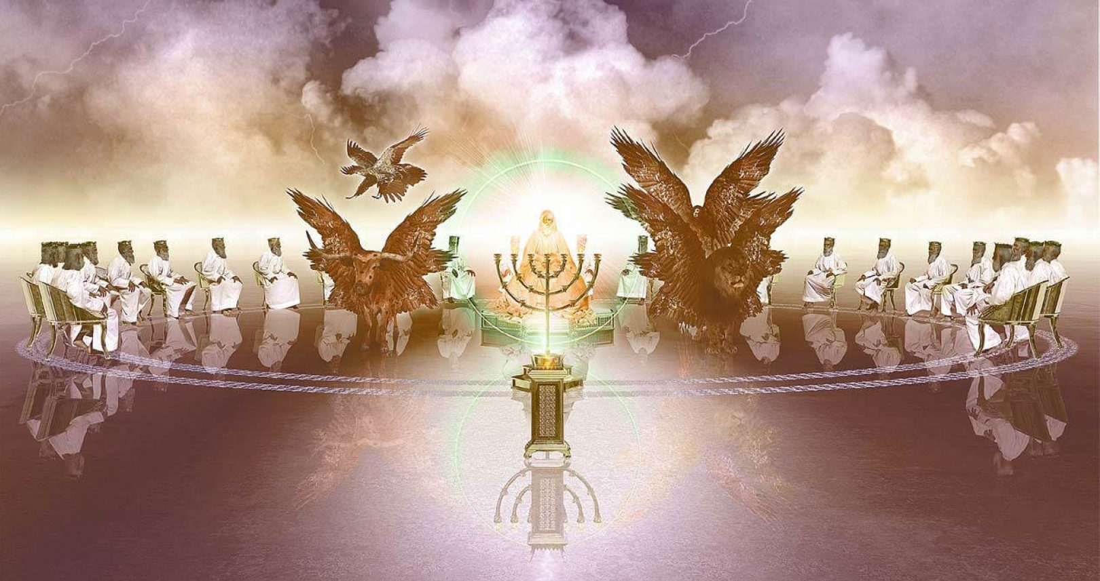
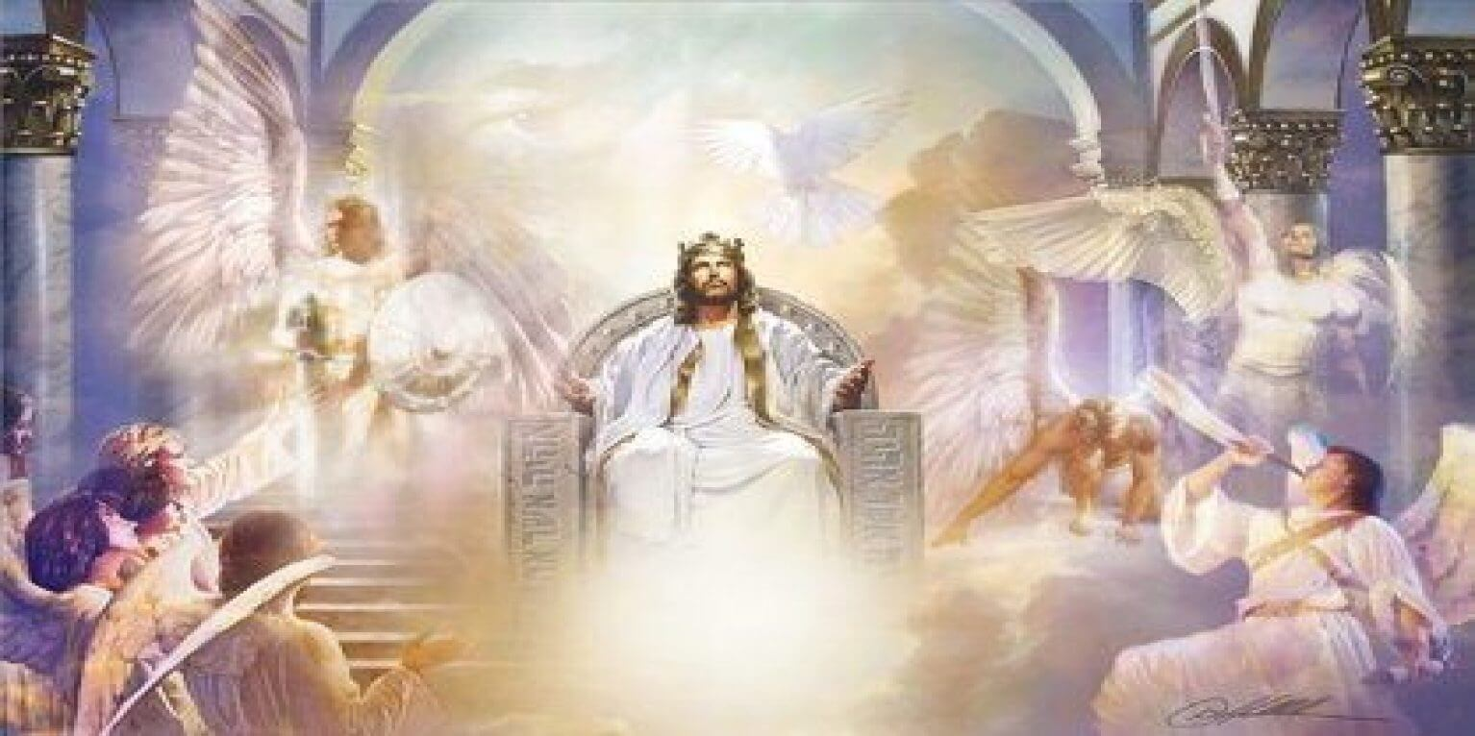
Haftarah Parashah Questions for Discussion
Isaiah 54:1 – 55:5
It is often noted by scholars and readers alike the Prophet Isaiah’s message first explains why Israel’s tragedies are occurring, then states the changes people need to make. A rebuke followed by hope and consolation, of a brighter future of return and redemption for Israel.
Identify the words of rebuke and hope in this parashah’s Isaiah reading.
What is the covenant of peace in verse ten and why does YHWH call it that?
What does this covenant have to do with Noah’s flood?
Name all the roles of YHWH towards His people in this reading, such as redeemer in verse eight.
What gives YHWH the right to claim at the end of verse five, “For thy Maker is thine husband; YHWH of hosts is his name; and thy Redeemer the Holy One of Israel; The Elohim [God] of the whole earth shall he be called”?
TORAH PARASHAH #2 “NOACH”

Slide 12
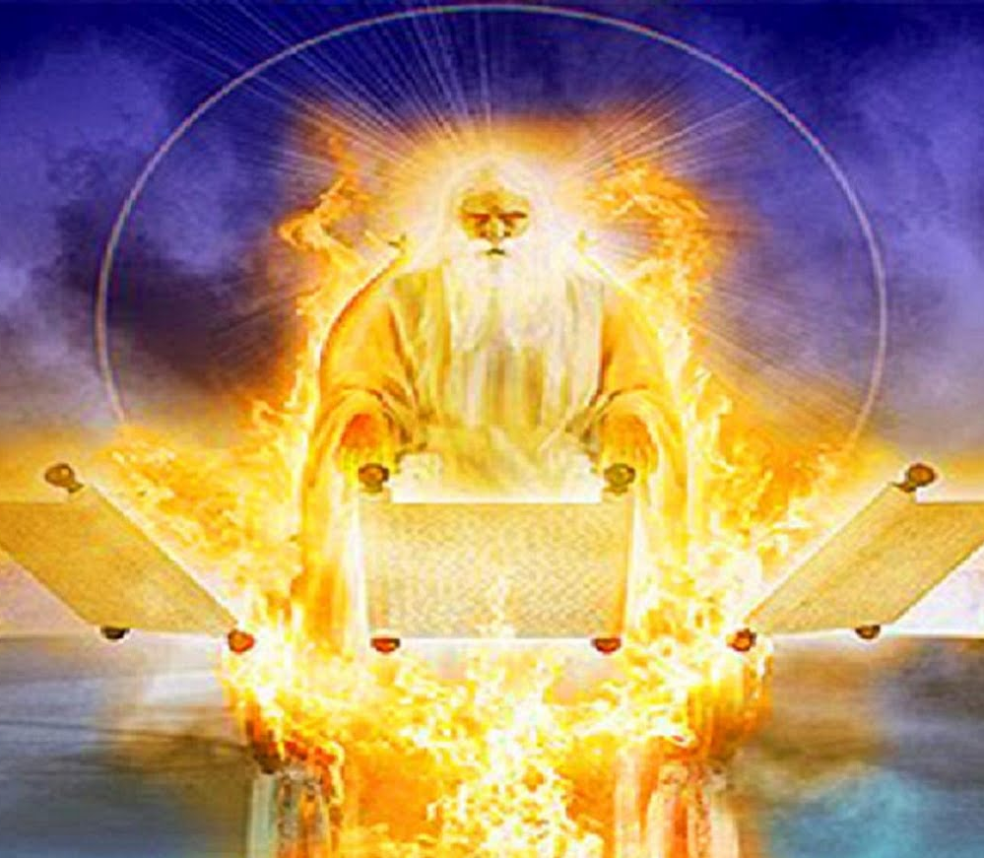
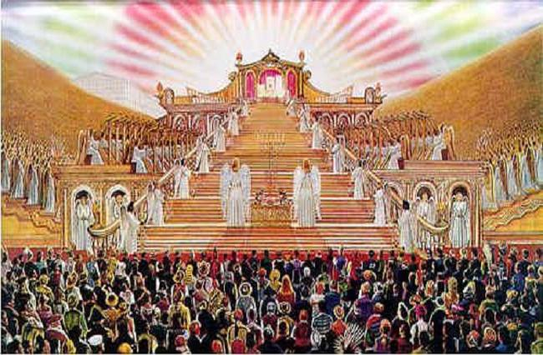
Gospel Parashah Questions for Discussion Luke 17:20 – 27
What kingdom is being discussed in this Gospel reading? Please share Scriptural answers to this question.
Does this talk of a kingdom occur a little or a lot with Yeshua and His disciples? If a lot, why is that?
What does this parashah reading have to do with Noah’s flood?
Defender of the Faith Time - Many skeptics claim the account of Noah’s flood is made up or a plagiarized version of the Epic of Gilgamesh. If made up, what does this do to Yeshua’s credibility in verses 26-27? Could He claim the title Son of Man, as He does three times in this reading? Could He then die for our sins, a blameless, sinless sacrifice?
Bonus Sharing Time-In this worksheet I have mentioned skeptics, people who are always with us, like bad weather. Explain Yeshua’s many examples of dealing with skeptics, such as in this reading, and how this equips us to deal with them today.

Slide 13
