Slide 1
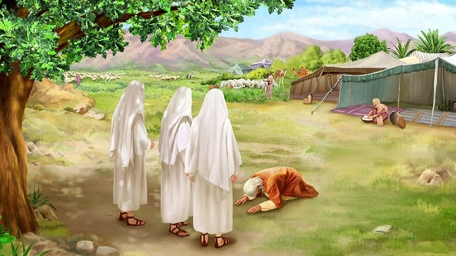
TORAH PARASHAH #4 “VAYERA”
B’REISHEET 18:1-22:24 2 KINGS 4:1- 37 LUKE 17:28-37

Slide 2
Blessing Before the Reading of the Torah
[Leader:]
Ba-r’chu et Yah-u-eh ha-m’vo-rach!
Bless Yahueh, the Blessed One
[All:]
Ba-ruch Yah-u-eh, ha-m’vo-rach l’o-lam va-ed!
Blessed is Yahueh, the Blessed One, for all eternity
[Leader:]
Ba-ruch Yah-u-eh ha-m’vo-rach l’o-lam va-ed!

Slide 3
Ba-ruch a-tah Yah-u-eh, E-lo-hei-nu me-lech ha-o-lam
Blessed are You, Yahueh our Elohim, King of the Universe
a-sher ba-char ba-nu-mi-kol ha-a-min
Who has chosen us from among all peoples
v’na-tan la-nu et-To-ra-to
And gave us His Torah
Ba-ruch a-tah Yah-u-eh,
Blessed are You Yahueh
[All:] (Baruch Sh’mo)
Bless His Name
no-tein ha-torah.
Giver of the Torah!
[All:] (A-mein)

Slide 4
TODAY’S TORAH READING B’reisheet 19:1-38
(1) And there came two angels to Sodom at even; and Lot sat in the gate of Sodom: and Lot seeing them rose up to meet them; and he bowed himself with his face toward the ground; (2) And he said, Behold now, my lords, turn in, I pray you, into your servant's house, and tarry all night, and wash your feet, and ye shall rise up early, and go on your ways. And they said, Nay; but we will abide in the street all night. (3) And he pressed upon them greatly; and they turned in unto him and entered into his house; and he made them a feast, and did bake unleavened bread, and they did eat. (4) But before they lay down, the men of the city, even the men of Sodom, compassed the house round, both old and young, all the people from every quarter: (5) And they called unto Lot, and said unto him, Where are the men which came into thee this night? bring them out unto us, that we may know them. (6) And Lot went out at the door unto them, and shut the door after him, (7) And said, I pray you, brethren, do not so wickedly. (8) Behold now, I have two daughters which have not known man; let me, I pray you, bring them out unto you, and do ye to them as is good in your eyes: only unto these men do nothing; for therefore came they under the shadow of my roof. (9) And they said, Stand back. And they said again, This one fellow came into sojourn, and he will needs be a judge: now will we deal worse with thee, than with them. And they pressed sore upon the man, even Lot, and came near to break the door.

Slide 5
TODAY’S TORAH READING B’reisheet 19:1-38
(10) But the men put forth their hand, and pulled Lot into the house to them, and shut to the door. (11) And they smote the men that were at the door of the house with blindness, both small and great: so that they wearied themselves to find the door. (12) And the men said unto Lot, Hast thou here any besides? son in law, and thy sons, and thy daughters, and whatsoever thou hast in the city, bring them out of this place: (13) For we will destroy this place, because the cry of them is waxen great before the face of YHWH; and YHWH hath sent us to destroy it. (14) And Lot went out, and spake unto his sons in law, which married his daughters, and said, Up, get you out of this place; for YHWH will destroy this city. But he seemed as one that mocked unto his sons in law. (15) And when the morning arose, then the angels hastened Lot, saying, Arise, take thy wife, and thy two daughters, which are here; lest thou be consumed in the iniquity of the city. (16) And while he lingered, the men laid hold upon his hand, and upon the hand of his wife, and upon the hand of his two daughters; YHWH being merciful unto him: and they brought him forth and set him without the city. (17) And it came to pass, when they had brought them forth abroad, that he said, Escape for thy life; look not behind thee, neither stay thou in all the plain; escape to the mountain, lest thou be consumed. (18) And Lot said unto them, Oh, not so, my Lord:

Slide 6
TODAY’S TORAH READING B’reisheet 19:1-38
(19) Behold now, thy servant hath found grace in thy sight, and thou hast magnified thy mercy, which thou hast shewed unto me in saving my life; and I cannot escape to the mountain, lest some evil take me, and I die: (20) Behold now, this city is near to flee unto, and it is a little one: Oh, let me escape thither, (is it not a little one?) and my soul shall live. (21) And he said unto him, See, I have accepted thee concerning this thing also, that I will not overthrow this city, for the which thou hast spoken. (22) Haste thee, escape thither; for I cannot do any thing till thou be come thither. Therefore, the name of the city was called Zoar. (23) The sun was risen upon the earth when Lot entered into Zoar. (24) Then YHWH rained upon Sodom and upon Gomorrah brimstone and fire from YHWH out of heaven; (25) And he overthrew those cities, and all the plain, and all the inhabitants of the cities, and that which grew upon the ground. (26) But his wife looked back from behind him, and she became a pillar of salt. (27) And Abraham gat up early in the morning to the place where he stood before YHWH: (28) And he looked toward Sodom and Gomorrah, and toward all the land of the plain, and beheld, and, lo, the smoke of the country went up as the smoke of a furnace. (29) And it came to pass, when Elohim destroyed the cities of the plain, that Elohim remembered Abraham, and sent Lot out of the midst of the overthrow, when he overthrew the cities in the which Lot dwelt.

Slide 7
TODAY’S TORAH READING B’reisheet 19:1-38
(30) And Lot went up out of Zoar, and dwelt in the mountain, and his two daughters with him; for he feared to dwell in Zoar: and he dwelt in a cave, he and his two daughters. (31) And the firstborn said unto the younger, Our father is old, and there is not a man in the earth to come in unto us after the manner of all the earth: (32) Come, let us make our father drink wine, and we will lie with him, that we may preserve seed of our father. (33) And they made their father drink wine that night: and the firstborn went in and lay with her father; and he perceived not when she lay down, nor when she arose. (34) And it came to pass on the morrow, that the firstborn said unto the younger, Behold, I lay yesternight with my father: let us make him drink wine this night also; and go thou in, and lie with him, that we may preserve seed of our father. (35) And they made their father drink wine that night also: and the younger arose and lay with him; and he perceived not when she lay down, nor when she arose. (36) Thus, were both the daughters of Lot with child by their father.
Gen 19:37 And the firstborn bare a son and called his name Moab: the same is the father of the Moabites unto this day. (38) And the younger, she also bare a son, and called his name Benammi: the same is the father of the children of Ammon unto this day.

Slide 8
Blessing after the reading of the Torah
[Leader:]
Ba-ruch a-tah Yah-u-eh, E-lo-hei-nu me-lech ha-o-lam
Blessed are You, Yahueh our Elohim, King of the Universe
a-sher na-tan la-nu to-rat e-met
Who has given us the Torah of truth
v’cha-yei o-lam na-ta be-to-chei-nu
and planted everlasting life within us!
Ba-ruch a-tah Yah-u-eh,
Blessed are You Yahueh
[All:] (Ba-ruch Sh’mo!)
Bless His Name
no-tein ha-To-rah
Giver of the Torah!
[All:] (A-mein)

Slide 9
TORAH PARASHAH #3 “VAYERA””
Torah Portion and Outline B’reisheet 18:1-22:24
Chapter 18:1 – 21 “Isaac's Birth Promised” cont. Chapter 18:22 – 33 “Abraham Intercedes for Sodom”
Chapter 19:1 – 22 “God Rescues Lot” Chapter 19:23 – 29 “God Destroys Sodom”
Chapter 19:30 – 38 “Lot and His Daughters” Chapter 20:1 – 18 “Abraham and Abimelech”
Chapter 21:1 – 7 “The Birth of Isaac” Chapter 21:8 – 21 “God Protects Hagar and Ishmael”
Chapter 21:22 – 34 “A Treaty with Abimelech” Chapter 22:1 – 24 “The Sacrifice of Isaac”
Haftarah Portion and Outline 2 Kings 4:1 -- 37
Chapter 4:1 -- 7 “Elisha and the Widow's Oil” Chapter 4:8 – 17 “Elisha and the Shunammite Woman”
Chapter 4:18 – 37 “Elisha Raises the Shunammite's Son”
Gospel Portion and Outline Luke 17:28 - 37
Chapter 17:28 - 37 “The Coming of the Kingdom” cont.
During today’s Torah Parashah discussions consider:
Where is Yeshua? How is this relevant to us today?

Slide 10
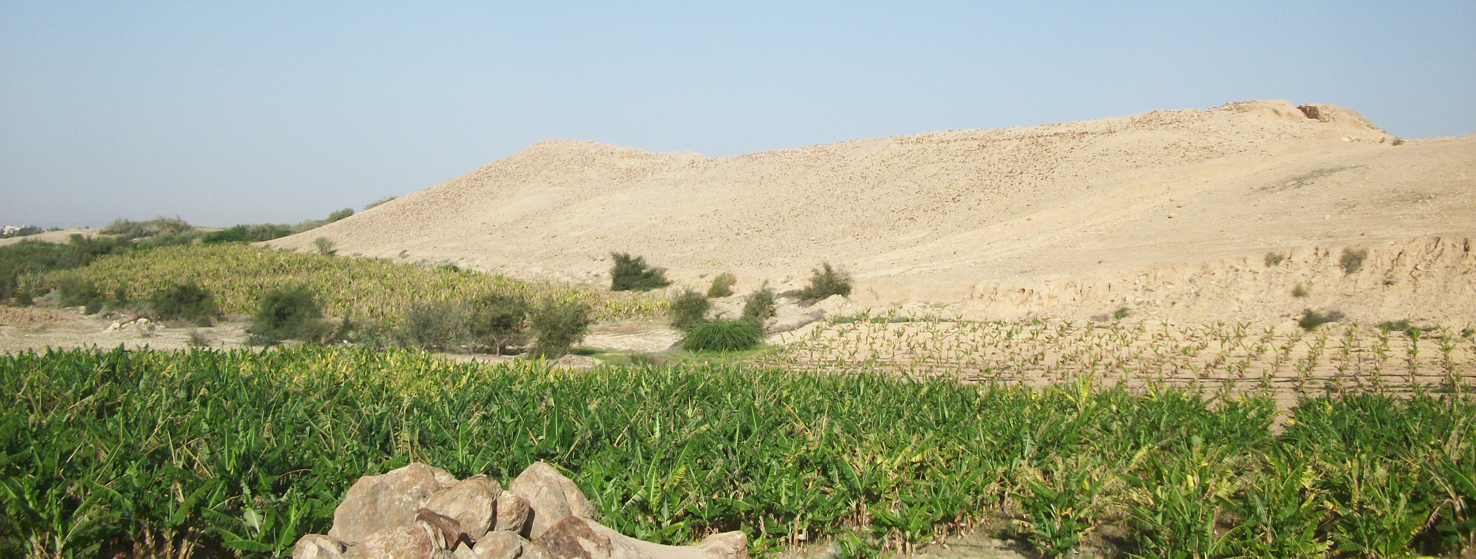
Torah Parashah Questions for Discussion
Once again, this Torah section covers amazing accounts too numerous to discuss in depth each Shabbat. However, it is my hope you will go through each of these chapters as I do with joy, hope and personal growth. May we share as much as time allows during our allotted Torah service, but also on the Band Channel set up for Torah discussion, and over a great oneg meal in the fellowship hall!
18:18 reads, “Seeing that Abraham shall surely become a great and mighty nation, and all the nations of the earth shall be blessed in him?” What was Abraham’s part to this amazing blessing?
TORAH PARASHAH #3 “VAYERA””

Slide 11
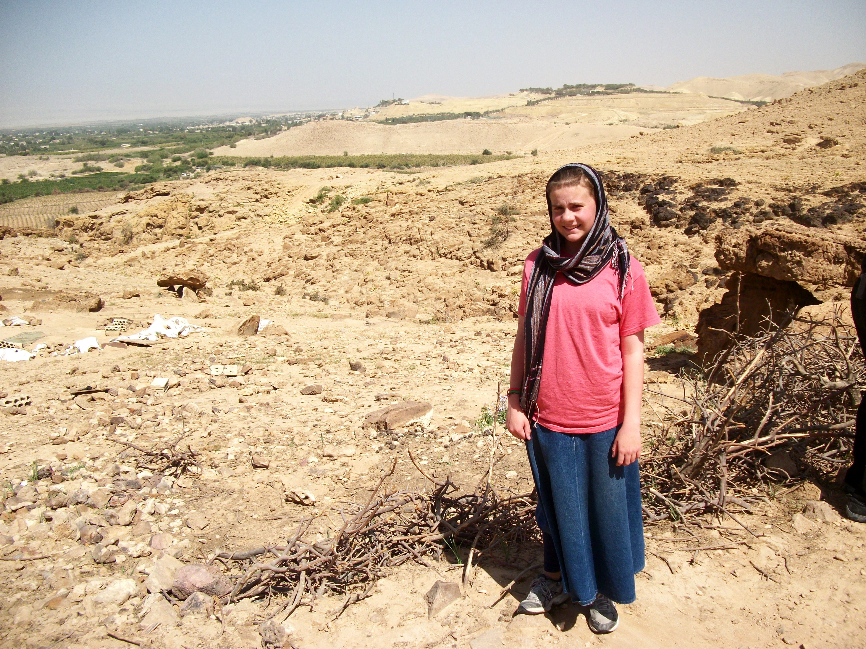
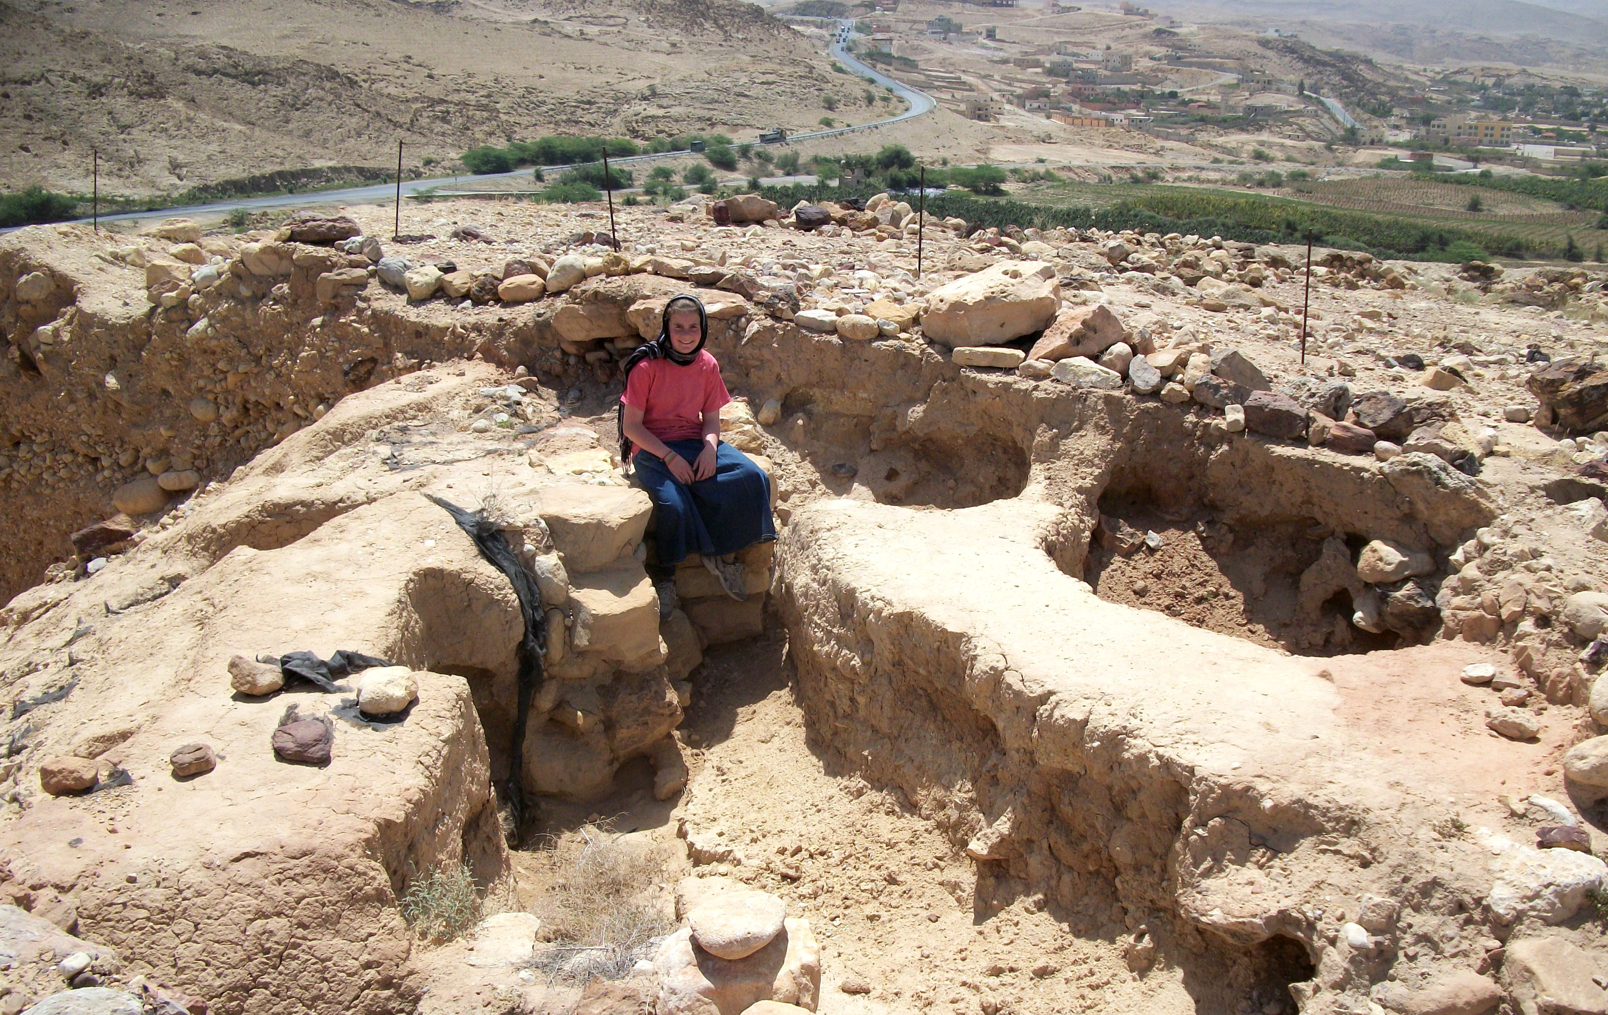
2. Abraham interceding for Sodom is truly a remarkable account, revealing so many truths and insights into YHWH, Abraham, and their relationship. Share some of these which you see during this section in the Torah service at Cornerstone.
3. 19:13 reads, “For we will destroy this place, because the cry of them is waxen great before the face of YHWH; and YHWH hath sent us to destroy it.” Whose cry is this?
TORAH PARASHAH #3 “VAYERA””

Slide 12
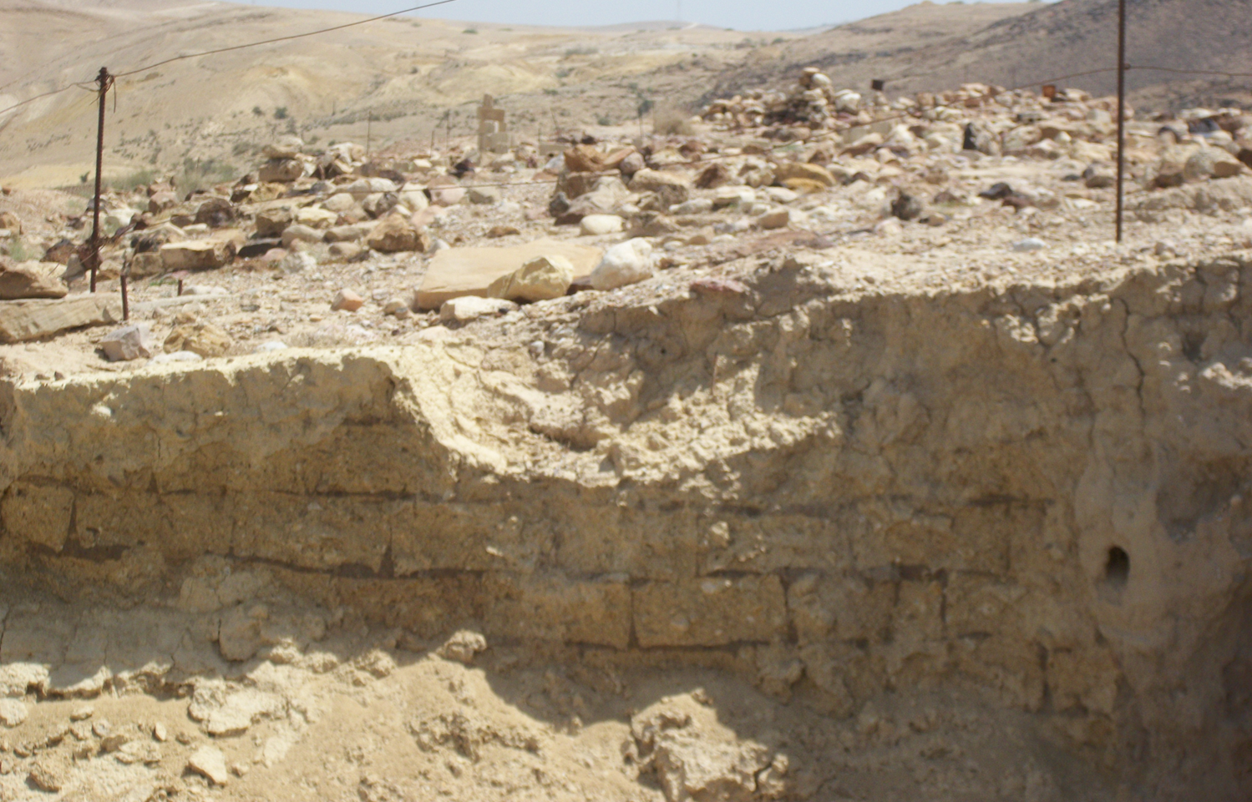
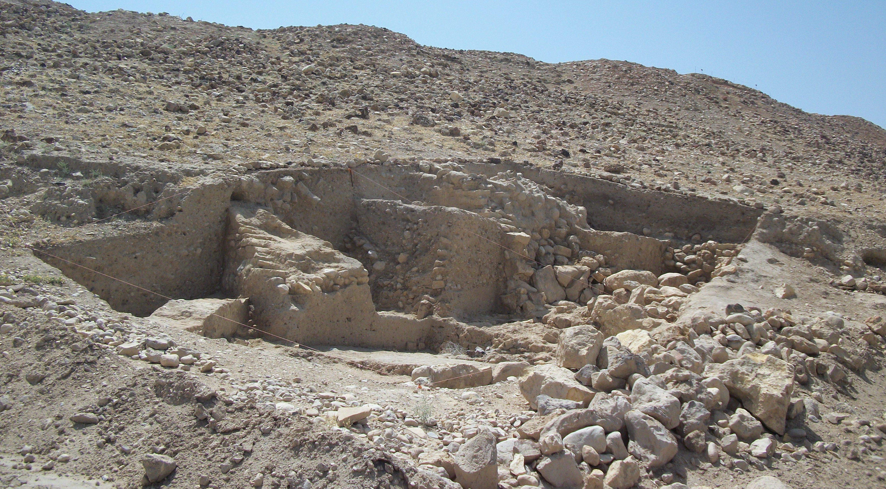
4, When YHWH destroys Sodom, Gomorrah and the cities of the plains, why does Lot’s wife die when she looks at them (v. 26) but Abraham lives (v. 28)?
5. Review question - What historic ramifications occur from Lot having relations with his two daughters?
TORAH PARASHAH #3 “VAYERA””

Slide 13
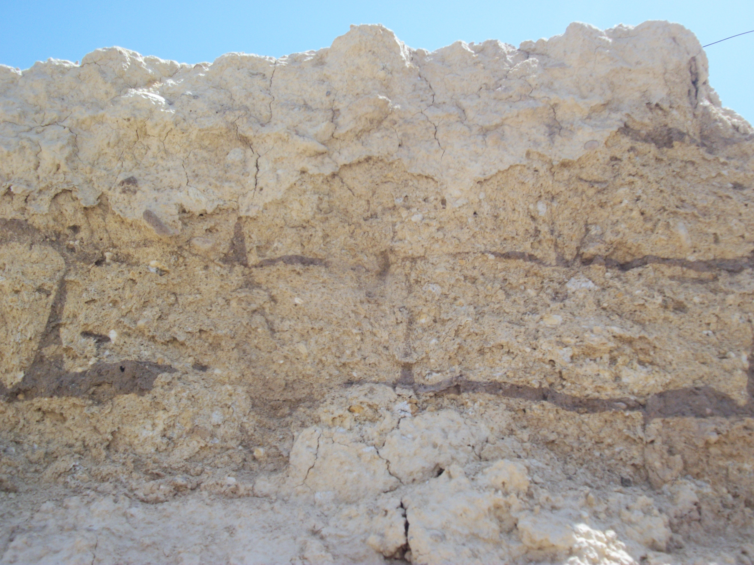
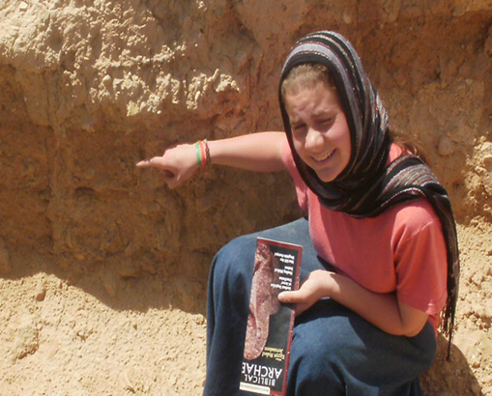
TORAH PARASHAH #3 “VAYERA””
6. Review question - Why does YHWH protect Hagar and Ishmael?
7. What character qualities of Abraham are revealed in his dealings with Abimelech?
8. Why is the sacrifice of Isaac central to our faith today? I mean, I thought it was just an old Jewish story.

Slide 14
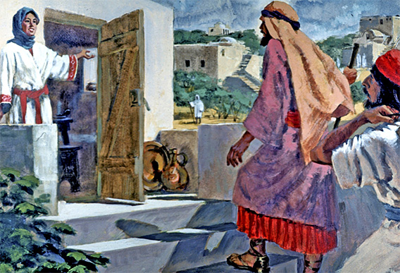
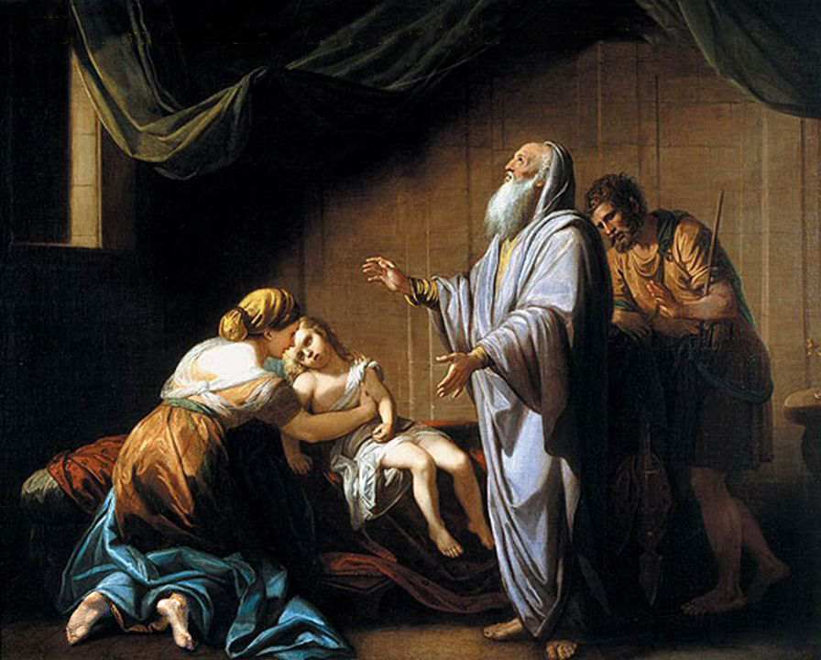
Haftarah Parashah Questions for Discussion
2 Kings 4:1 -- 37
Verse one mentions the “sons of the prophets.” (KJV) They are also mentioned in 1 Kings 20:35, 2 Kings 2:3,5 and 2 Kings 4:38. Who are they?
Research the heritage of the city and tribe of the Shunammite woman. Does this heritage have any significance in this story?
Why was oil used in this account? Regarding how YHWH works, do you see a tie between this account and when Yeshua turned water into wine? (Hint- ponder what these two elements represent in Scripture.)
I was often taught growing up that raising the dead was a New Testament concept. If so, how does one explain by what name or power this woman’s son was brought back to life?
List Scriptures where people are resurrected from the dead in the Tanach.
TORAH PARASHAH #3 “VAYERA””

Slide 15
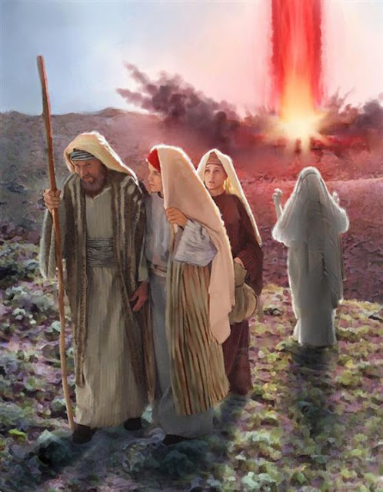
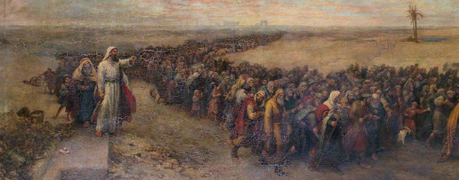
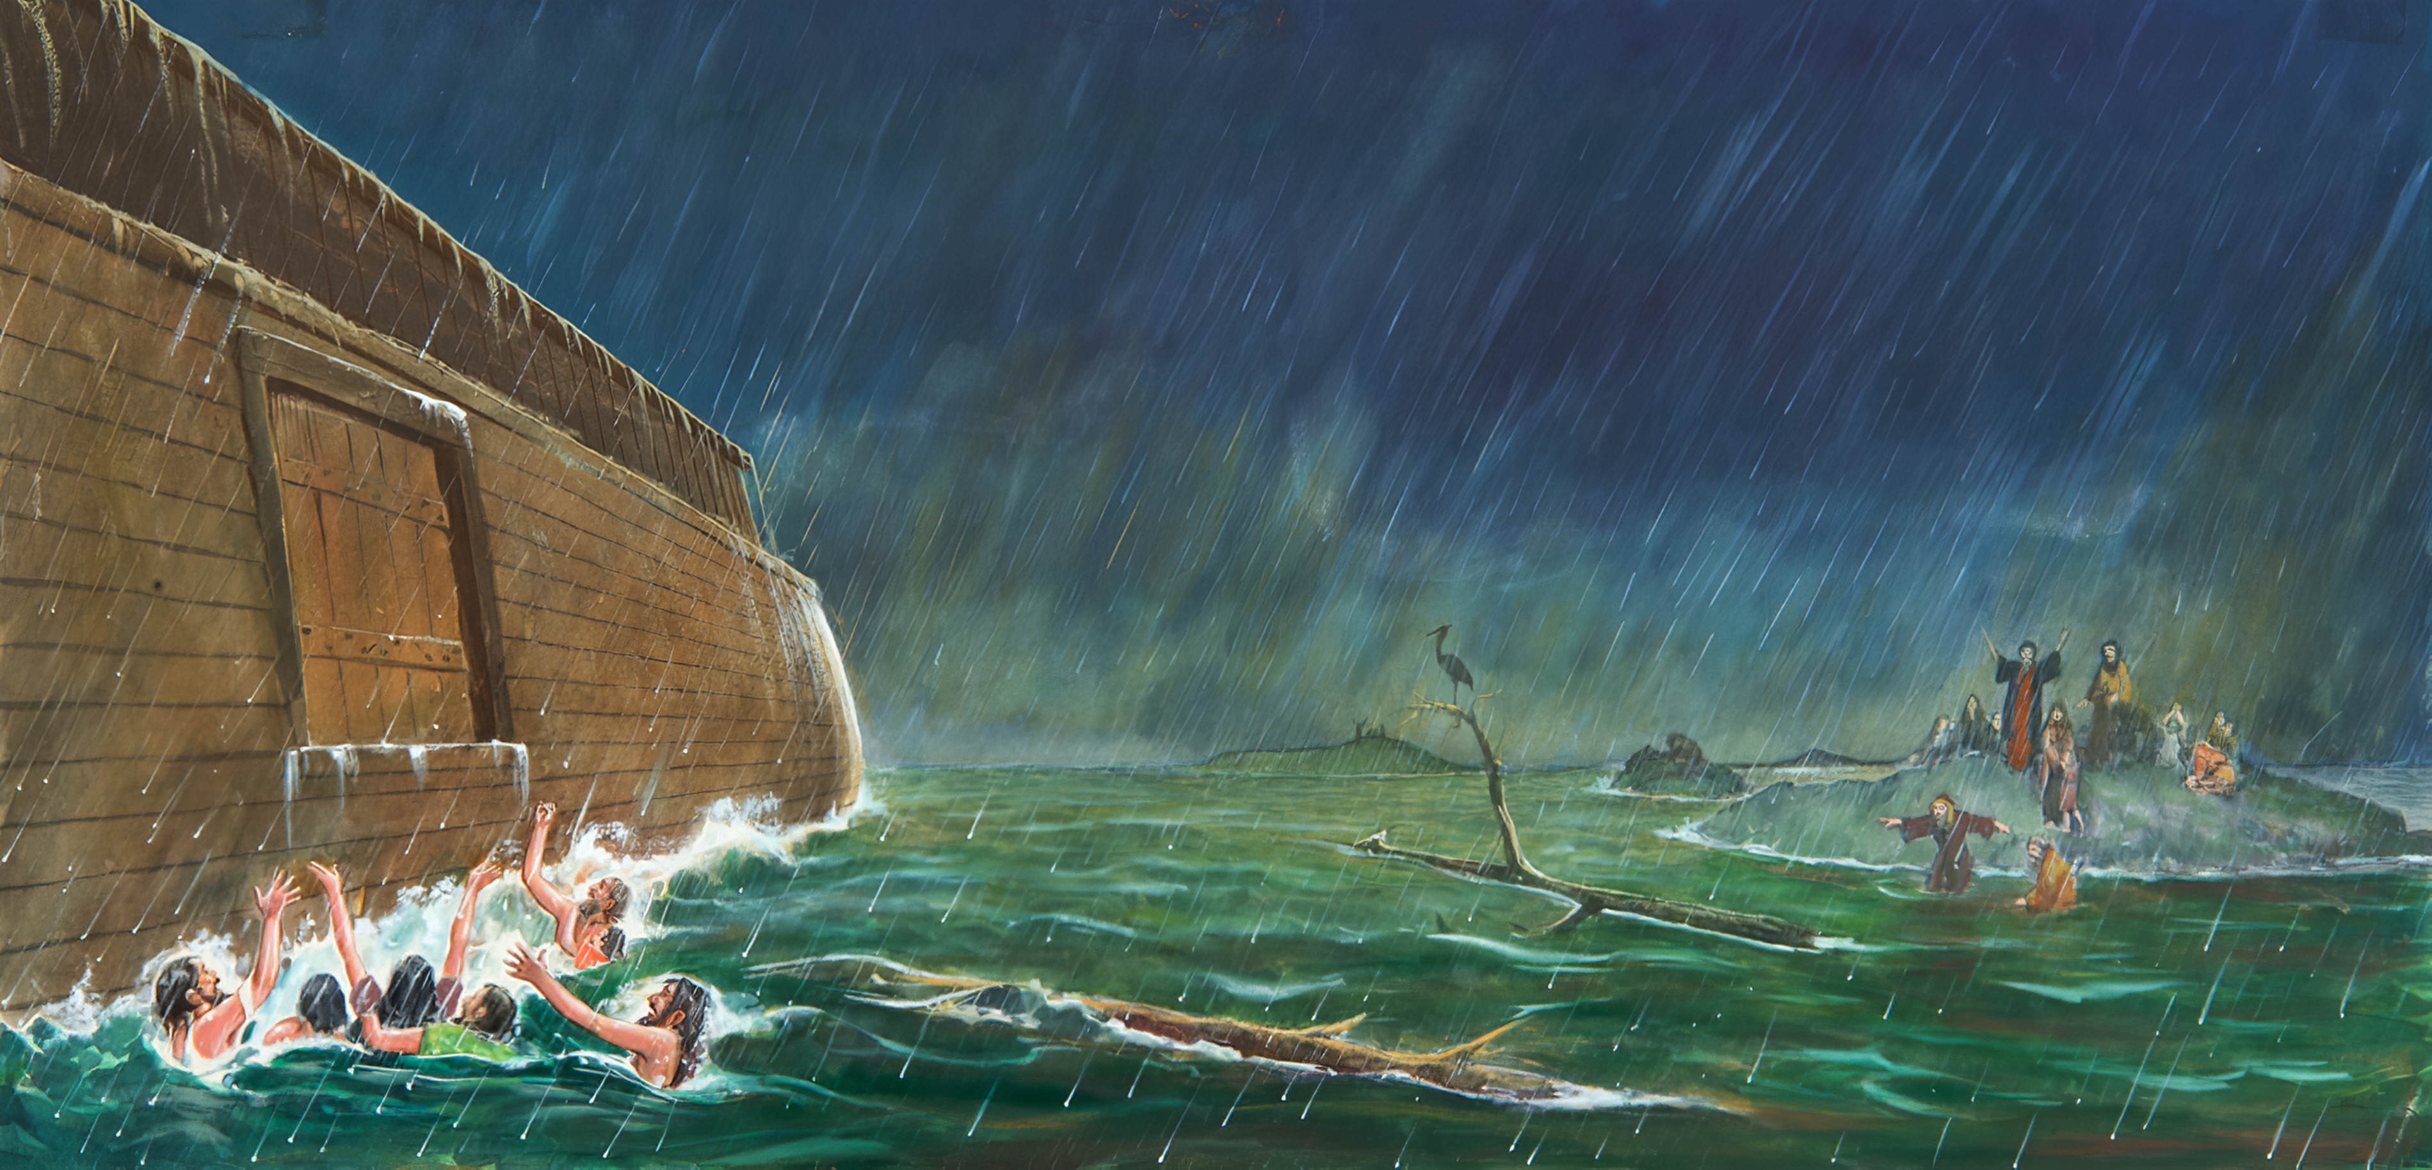
Gospel Parashah Questions for Discussion Luke 17:28-37
This is a very interesting section of Scripture to read. Which parts do you think are realistic, and which parts are symbolic? Can you back up your ideas with Scripture?
It is interesting that Yeshua draws parallels with the time of Noah, Lot and His second coming. Why does He do that?
Verse 31 reads, “In that day, he which shall be upon the housetop, and his stuff in the house, let him not come down to take it away: and he that is in the field, let him likewise not return back.” So, what should these people do instead of these examples?
Verse 33 reads, “Whosoever shall seek to save his life shall lose it; and whosoever shall lose his life shall preserve it.” What does Yeshua mean by this?
TORAH PARASHAH #3 “VAYERA””

Slide 16
TORAH PARASHAH #3 “VAYERA””

